Slide 1
Marketing Campaign Dashboard
Insights from Campaign Performance
Presented by –Aditya yadav

Slide 2
Overview of key Metrics
This tableau project analyses marketing campaign data
with a focus on clicks , spend , interest ,impressions, and conversions.
Derive insights from performance metrics to understand the effectives
of campaigns.

Slide 3
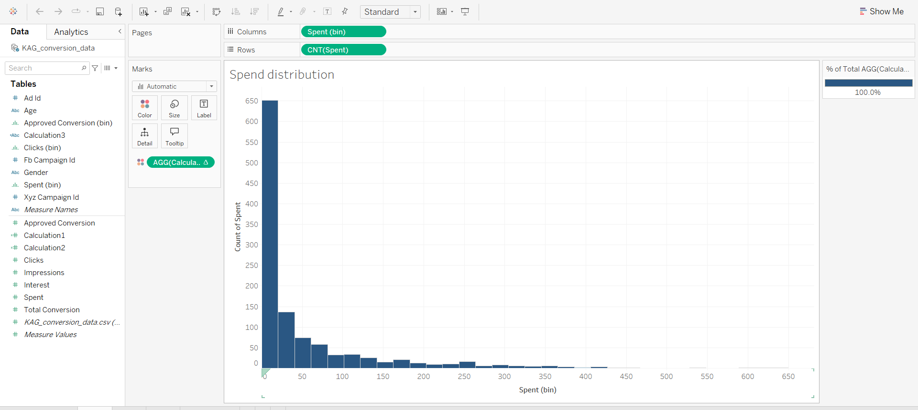
Spend Distribution
Sheet -1
This charts shows how campaign spend
Is distribution.
Formula Used:
Field binned : spend
Measure used: CNT(spend)

Slide 4
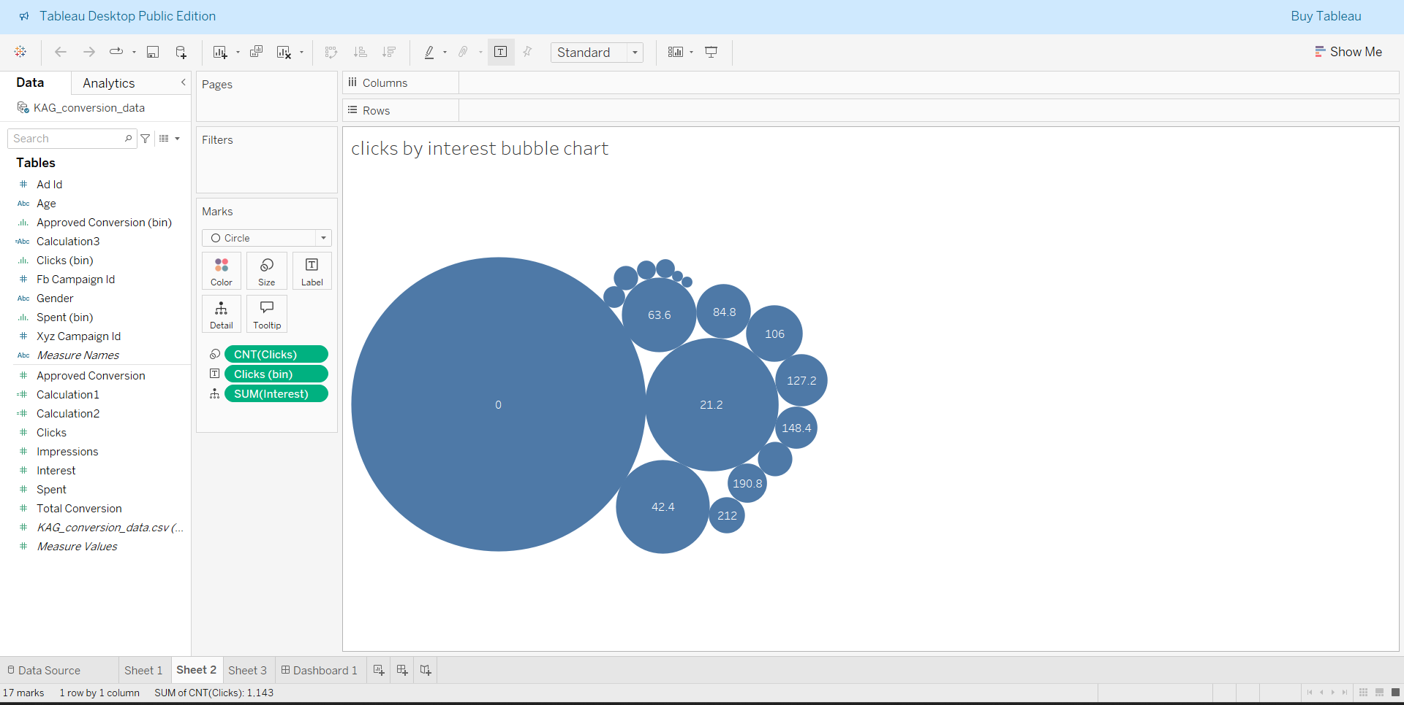
Clicks by interest – Bubble Chart
Sheet-2
This visualization shows how clicks are
Distributed across different levels of user
Interest.
Fields Used:
*Dimension: Clicks(bin)
* Measure:CNT(clicks),SUM(interest)

Slide 5
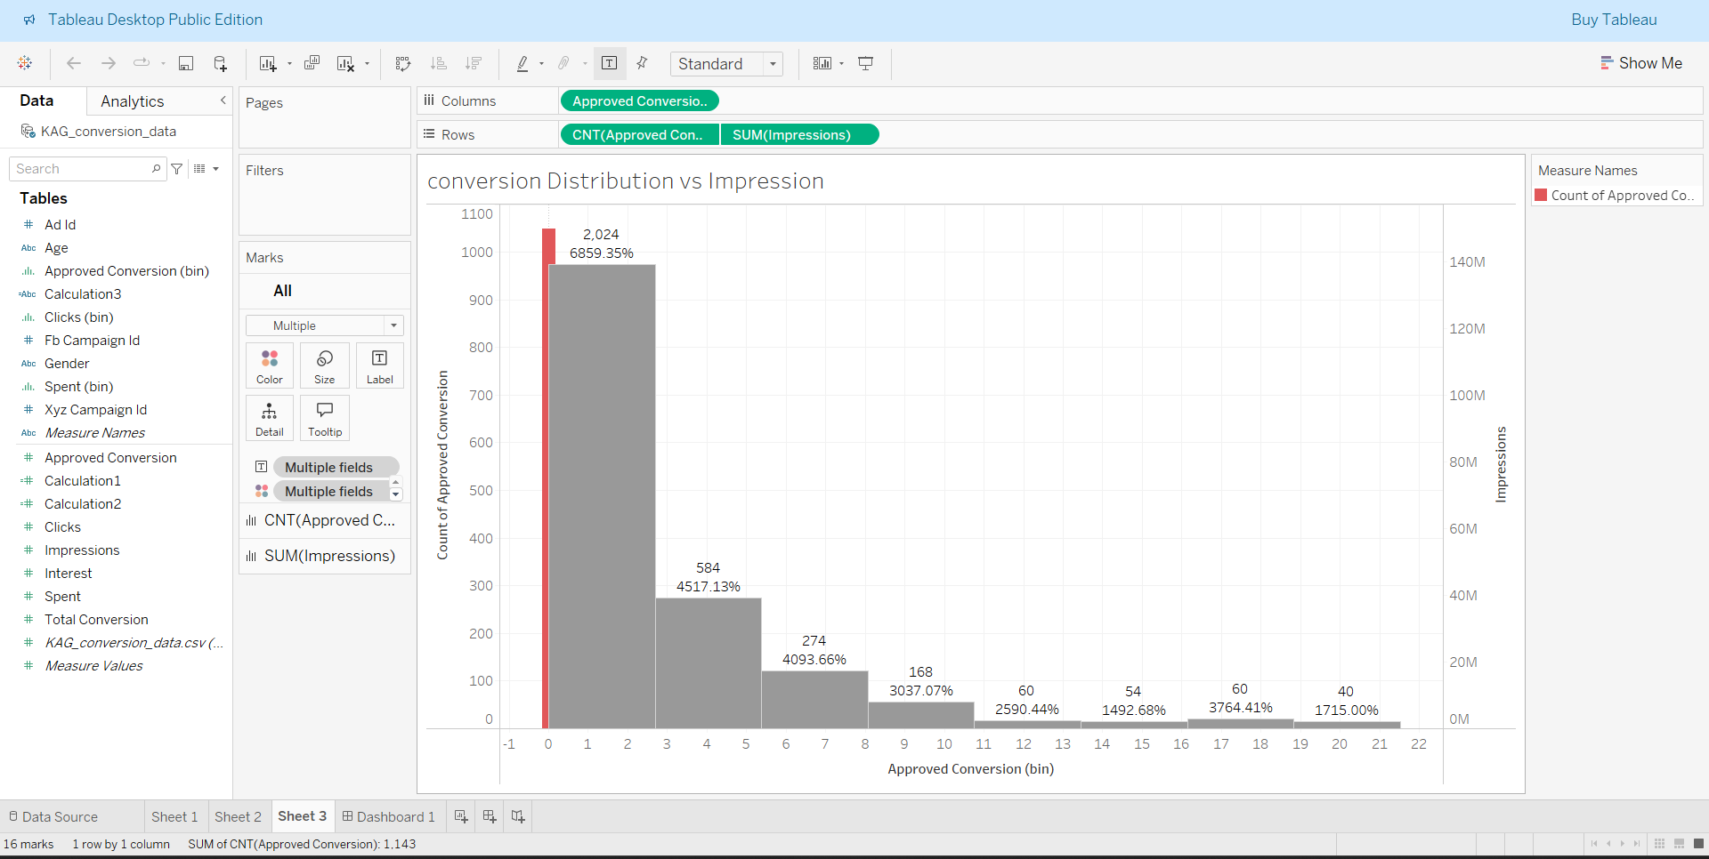
Conversion Distribution vs Impressions
Sheet-3
This visualization combines a bar
Chart and a line chart to analyze how
Approved conversions are distribution
And how they relate to total impression.
Key fields Used:
Columns –approved conversion(bin)
Rows –daul-axis: CNT(approved convers-
ion) and SUM (impression).

Slide 6
KPI formulas used:
Conversion Rate:
SUM([approved conversion])/SUM([clicks]).
Interest Rate:
SUM([interest])/CNT([clicks]).
Spend Effectiveness :
SUM ([approved conversion])/Sum([spent]).

Slide 7
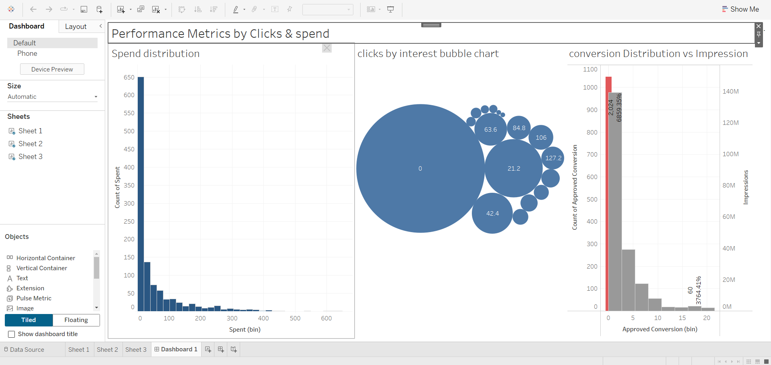
Dashboard Overview
Final Dashboard
Combined view of key metrics
across different visualizations.
Helps decision – makers identify
Trends in spend ,interest ,and
Performance.

Slide 8
Thank You

